Slide 1
Stage 2

Slide 2
Parts list
Part number | name
HC05 | Bluetooth module
LM7805 | Power management
LM2596 | Voltage step down
HC05 | Bluetooth communication
PCA9685 | Servo driver
MG995 | Servo motor
MPU6050 | Acc+Gyr
SL42STH40-1684A | Stepping motor
ULN2003 | Stepping motor driver
18F46K22 | Chips (proposed)
TB6617FNG | Motor Driver (proposed)
ADXL345 | Digital Accelerometer (proposed?)

Slide 3
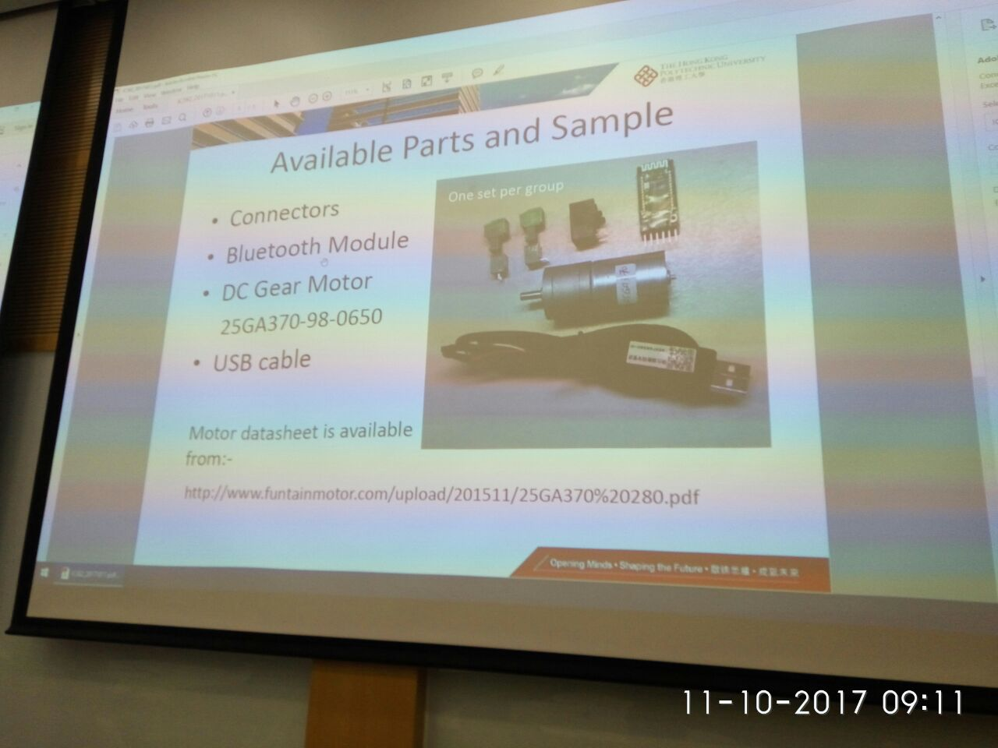

Slide 4
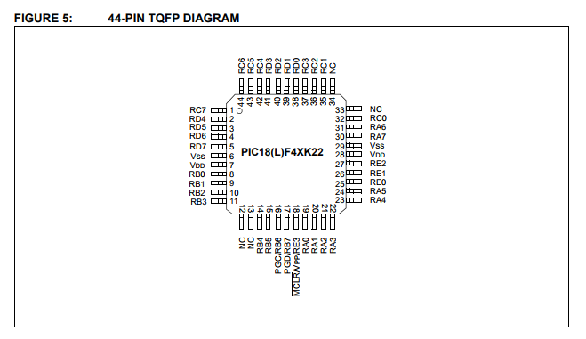
Motor PIC
Part num | Name | Datasheet
HC05 | Bluetooth | link
PIC18F46K22 | MCU | Link, web
25GA370 | Motor | link
MPU6050 (GY521) | Acc + gyro | link
TB6617FNG | Motor driver | link
LM1117 | Linear regulator(LowDrop) | link
SV01A103AEA01R00 | Rotary Position Sensor | link
/ | Buzzer
/ | LED
AMS1117 | Linear regulator(LowDrop) | link
TB6612FNG | Motor driver

Slide 5
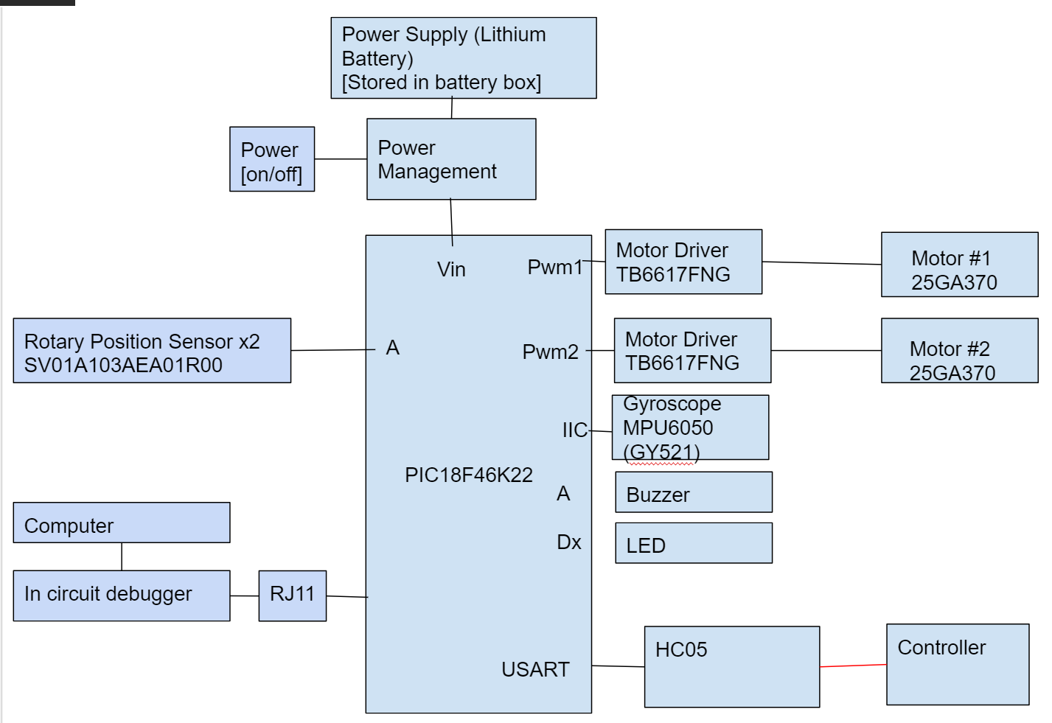

Slide 6
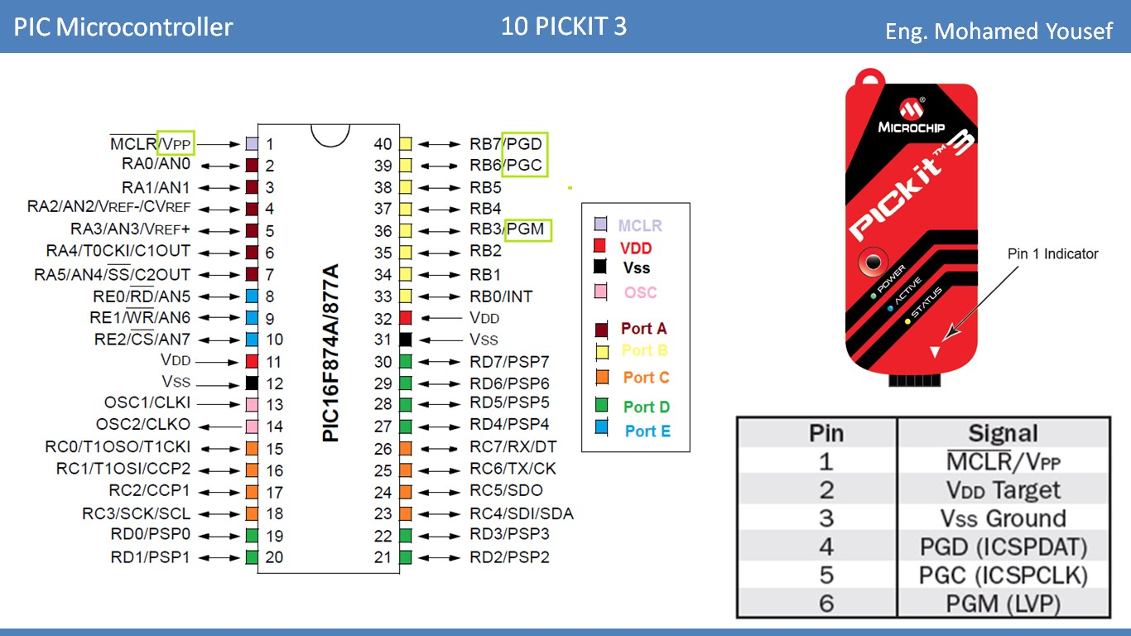
Other components
Crystal: 16MHz

Slide 7
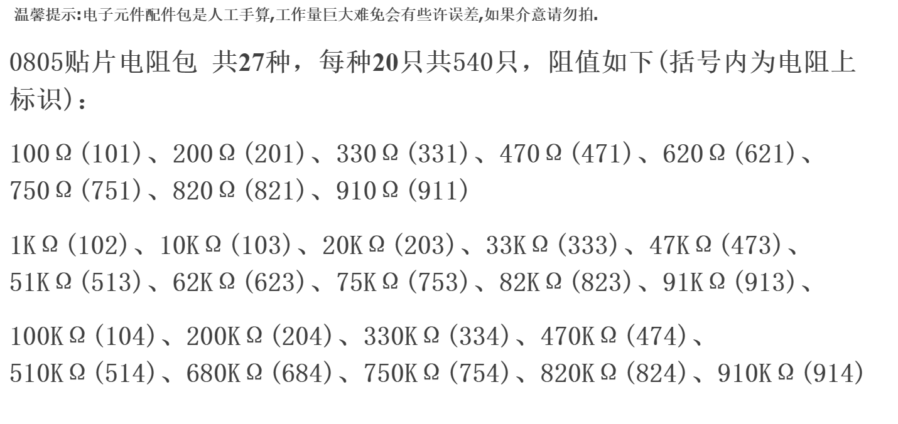
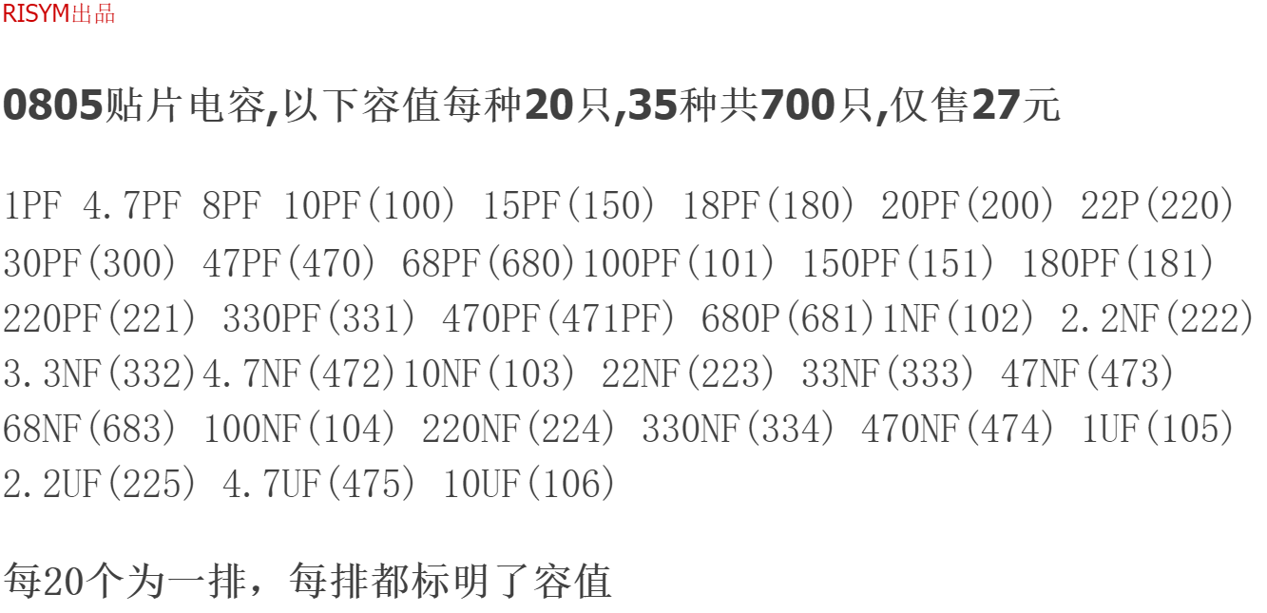

Slide 8
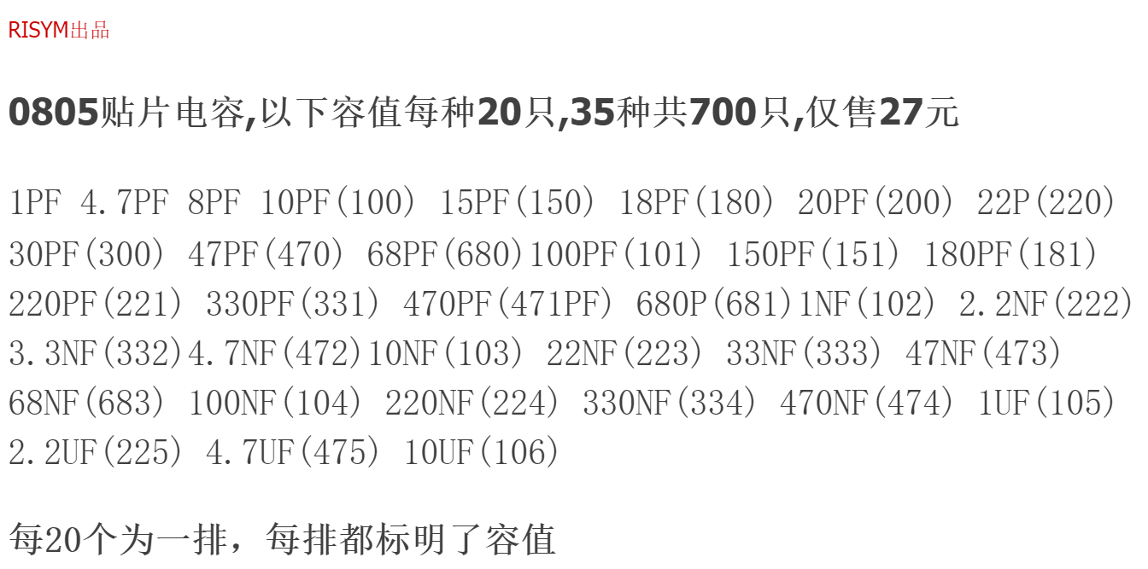

Slide 9
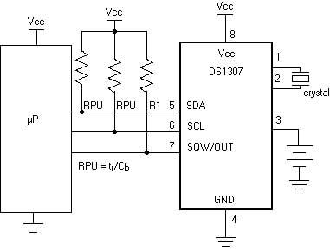
IIC (to sensor)
https://electrosome.com/i2c-pic-microcontroller-mplab-xc8/ MPLAB?

Slide 10
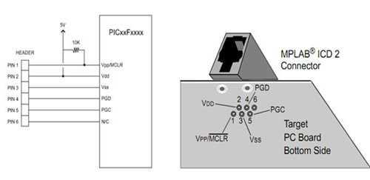
RJ11
Ref 2: http://www.embedinc.com/picprg/icsp.htm
Ref: http://microchipdeveloper.com/tls0201:debugger-connection-to-target

Slide 11
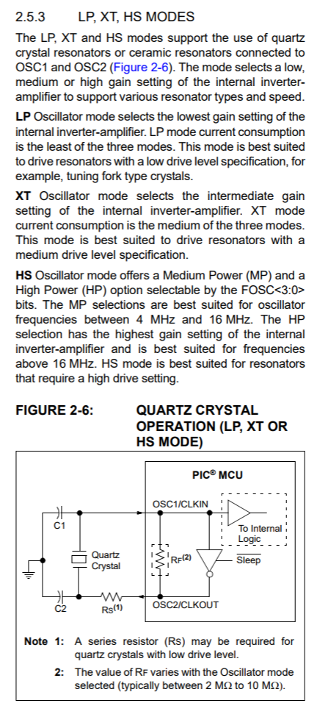
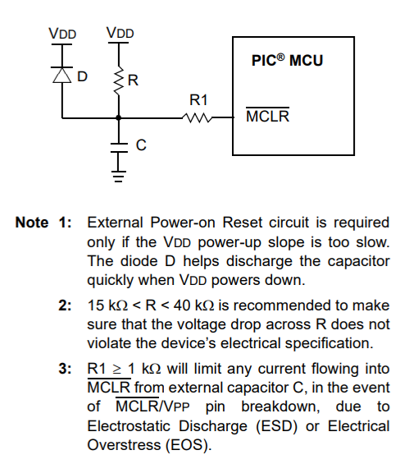
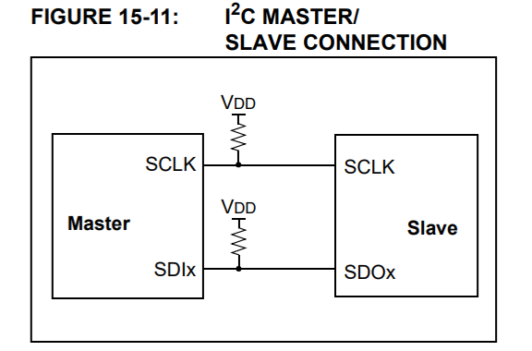
PIC18F46K22
2.3V to 5.5V Operation – PIC18FXXK22 devices
Reset circuit (4.3)
RES0805
P.215

Slide 12
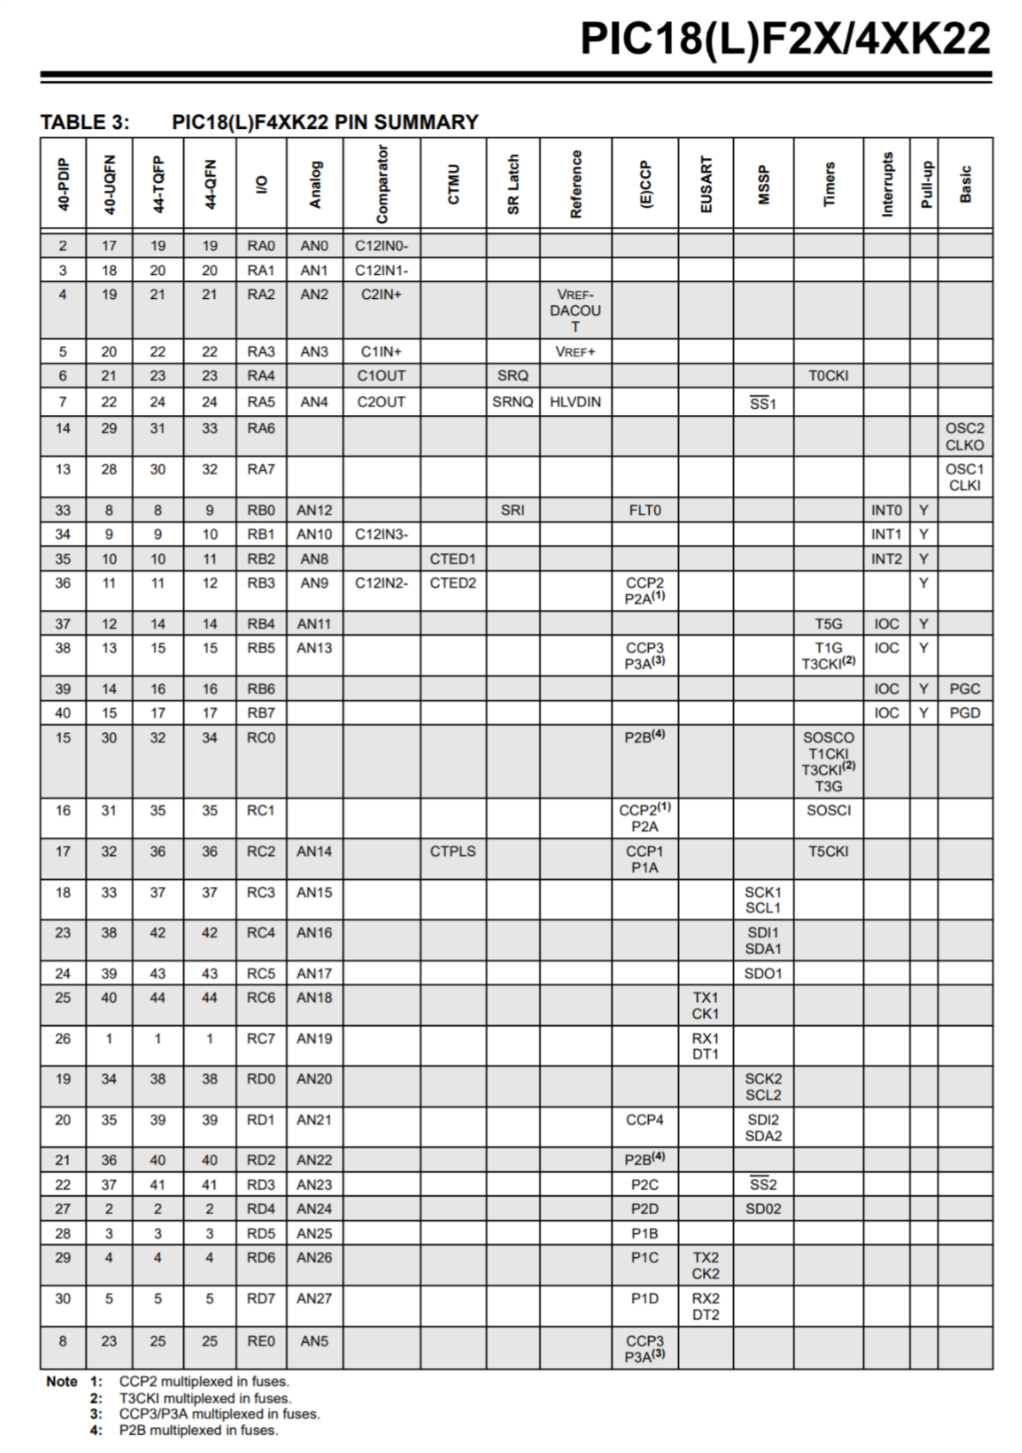
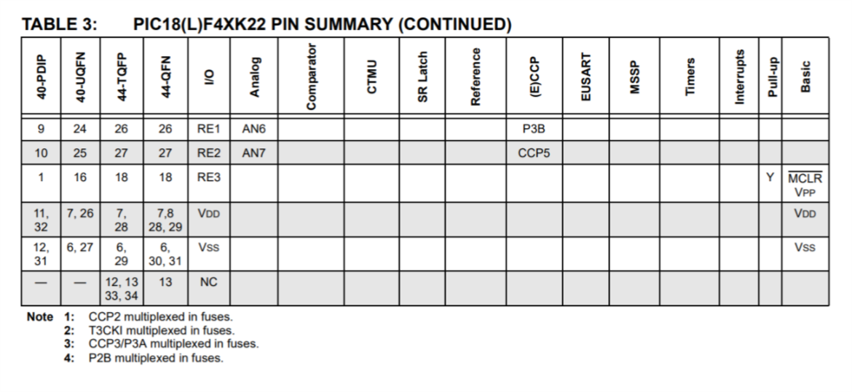
Reset Circuit
ICD & RJ11
Clock
USART
L_STBY
IIC
L_IN2
L_IN1
L_PWM
R_PWM
R_IN1
MOTOR
R_IN2
R_STBY

Slide 13
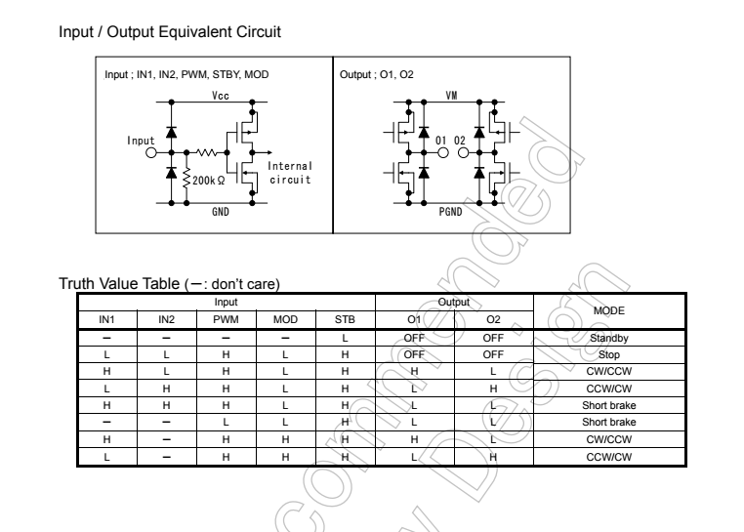
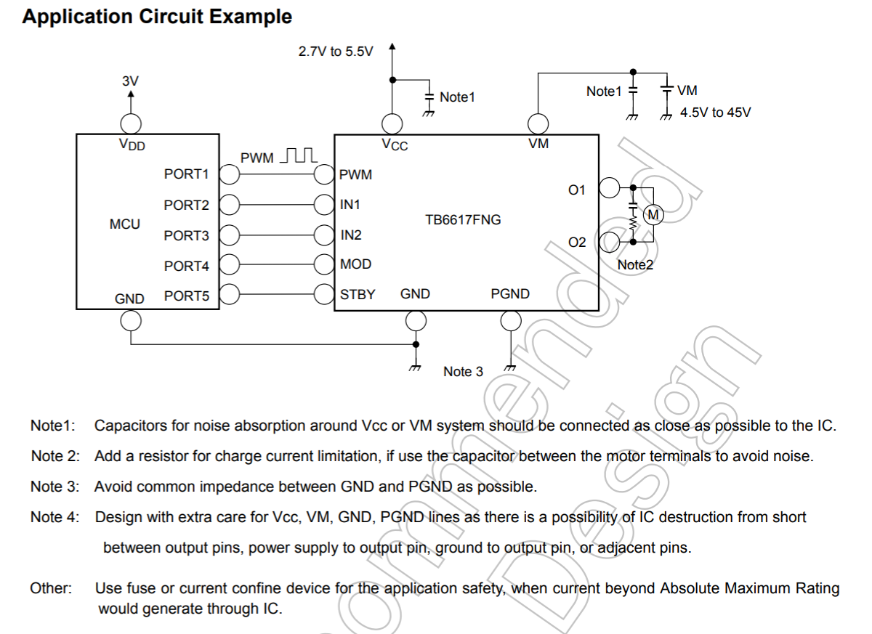
Motor Driver TB6617FNG

Slide 14
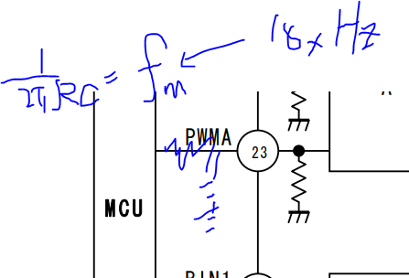
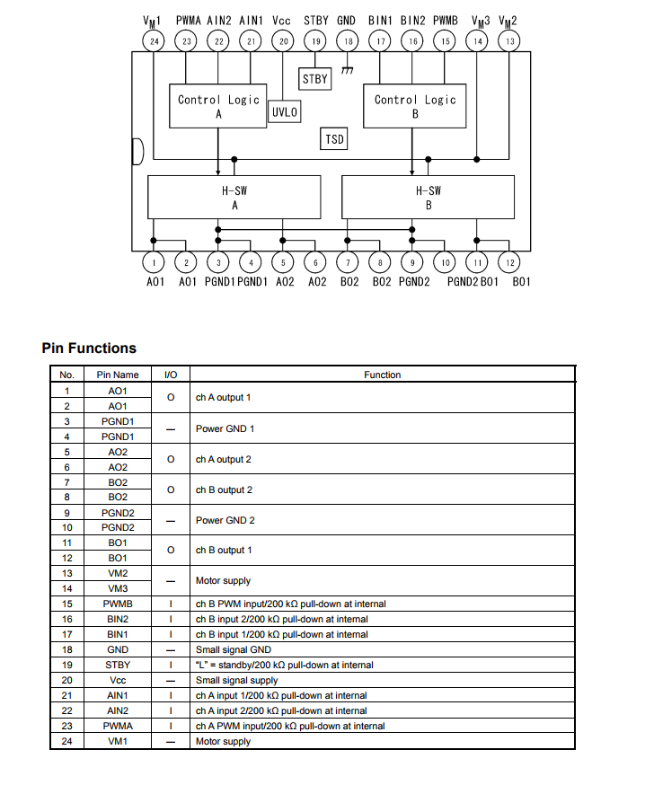
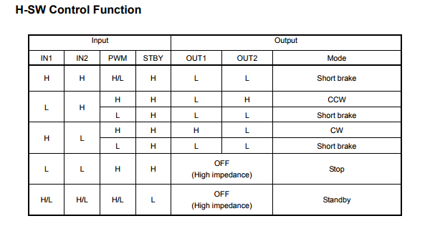
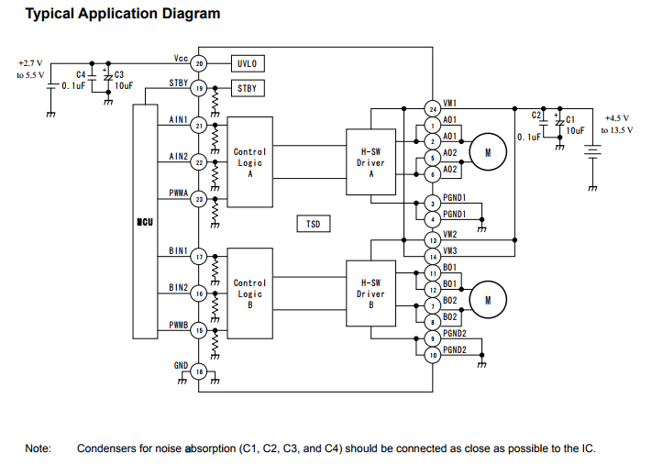
TB6612FNG

Slide 15
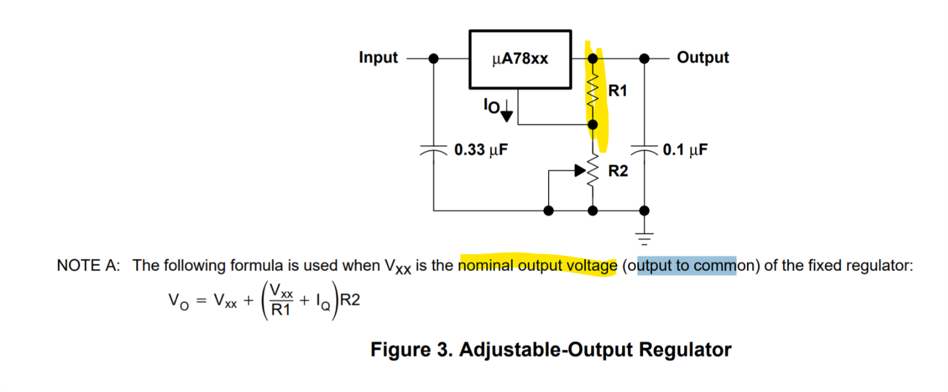
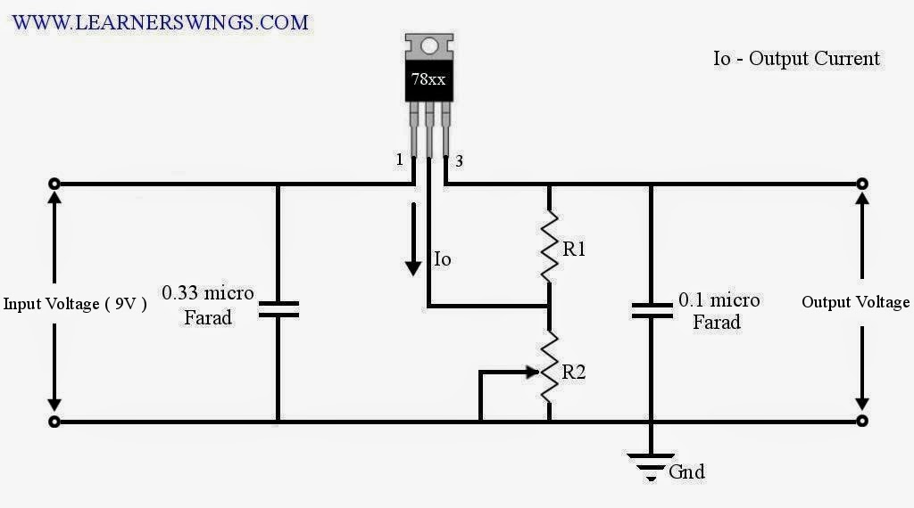
LM7805
http://www.learnerswings.com/2014/07/adjustable-output-voltage-regulator.html

Slide 16
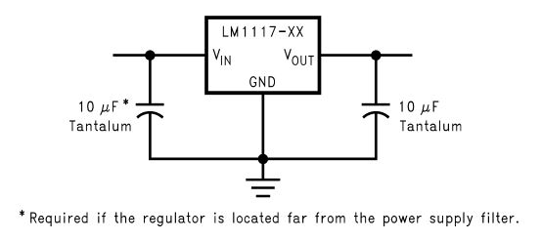
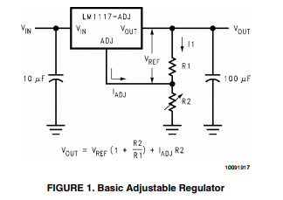
LM1117

Slide 17
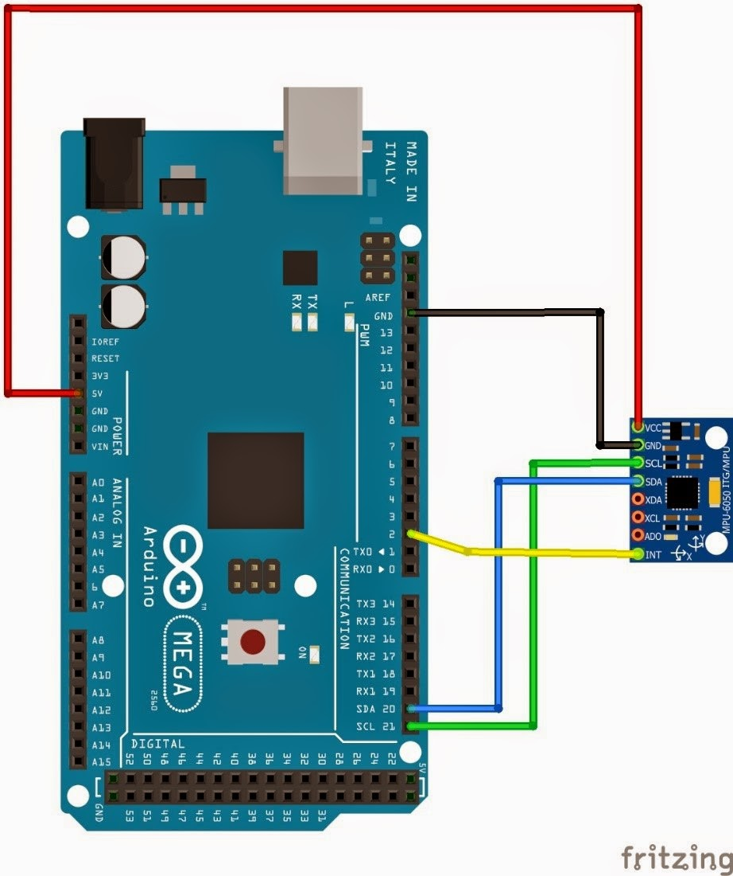
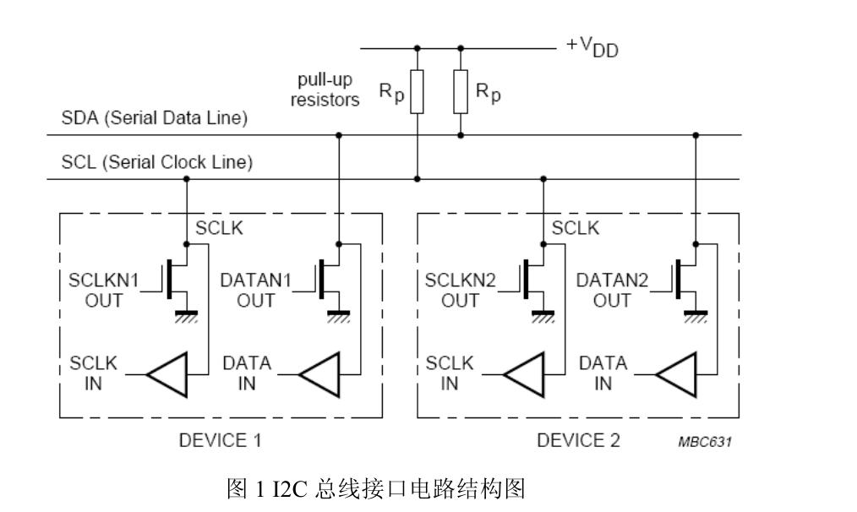
MPU6050

Slide 18
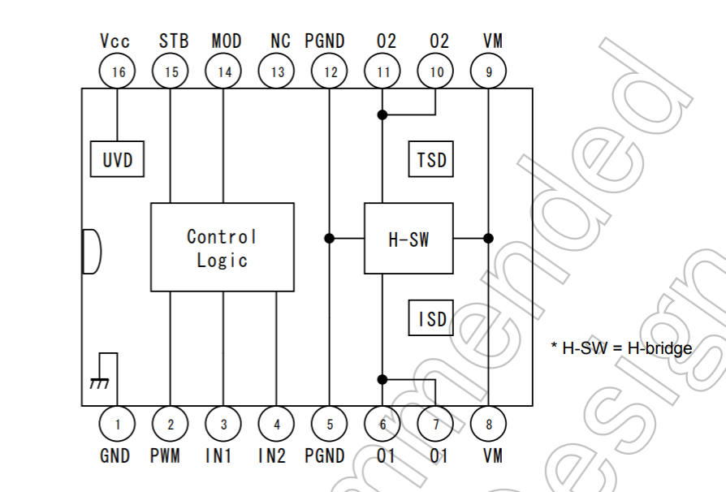

Slide 19
Controller NANO
Part numv | Name | Datasheet
HC05 | Bluetooth | link
Arduino Pro Mini/Nano | MCU | link
2-axis joystick | Mushroom | link
ADXL345 | Accelerometer (IIC) | link
/ | Lithium Battery x2
/ | Button(s)
Mini-360 | Voltage regulator

Slide 20
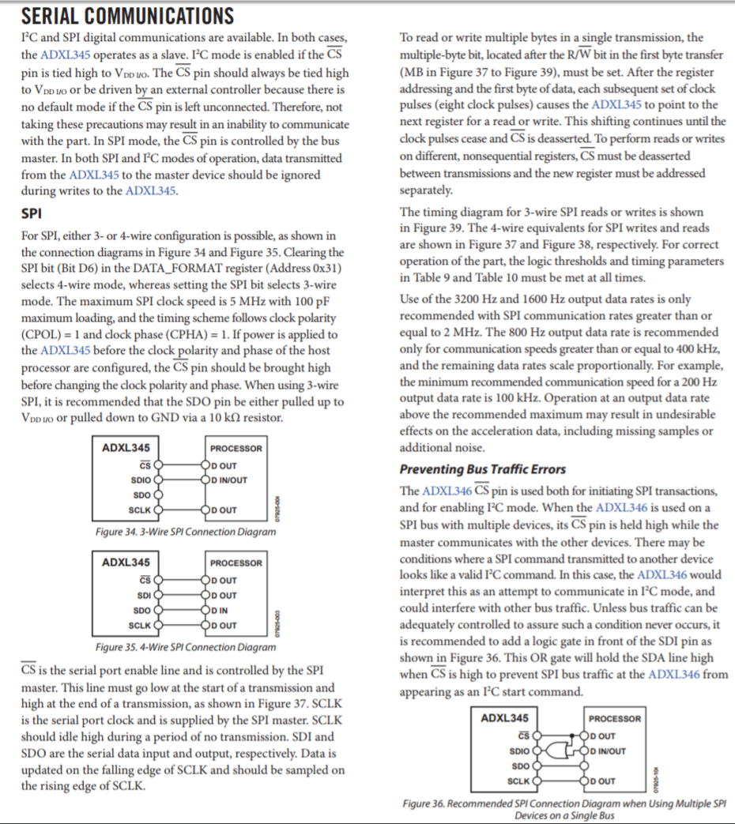
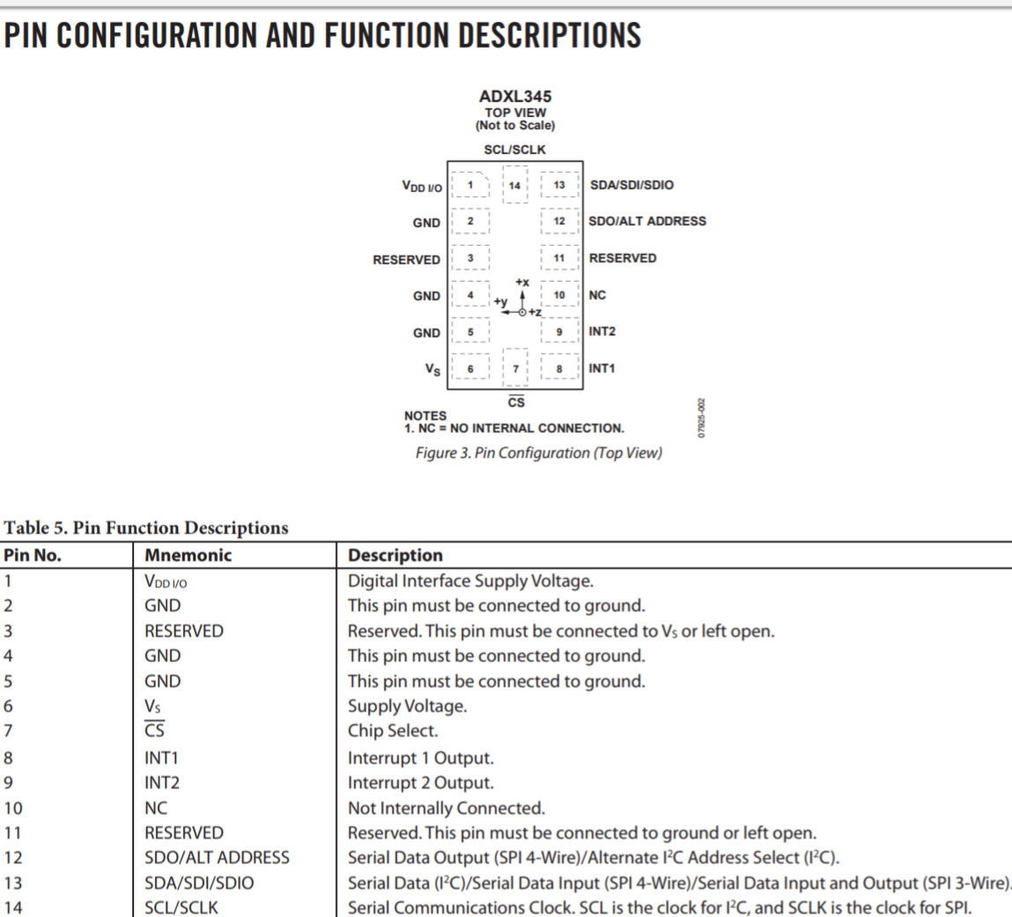
ADXL345
I/O voltage 2.0V-3.6V
Notes:
https://webduino.io/tutorials/tutorial-23-adxl345.html
http://lolikitty.pixnet.net/blog/post/165475299-arduino-%E5%85%A5%E9%96%80%E6%95%99%E5%AD%B8%EF%BC%9A%E8%AE%80%E5%8F%96-adxl345-%E4%B8%89%E8%BB%B8%E5%8A%A0%E9%80%9F%E5%BA%A6%E8%A8%88

Slide 21
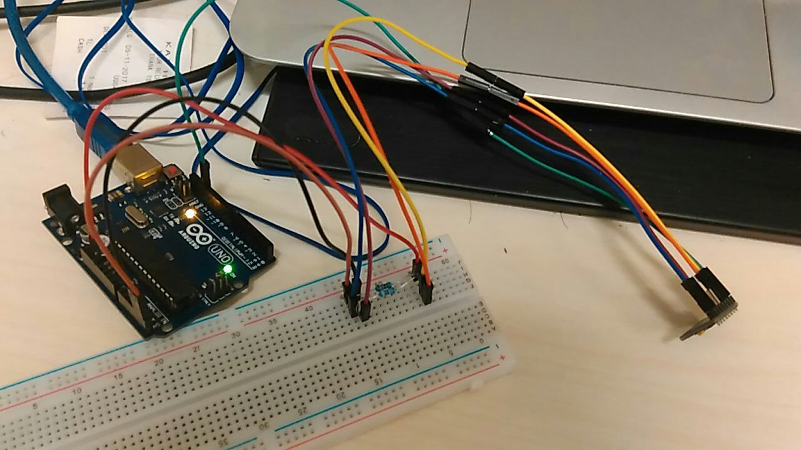
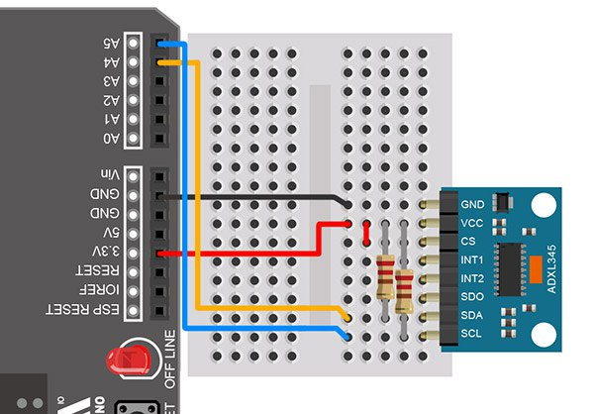

Slide 22
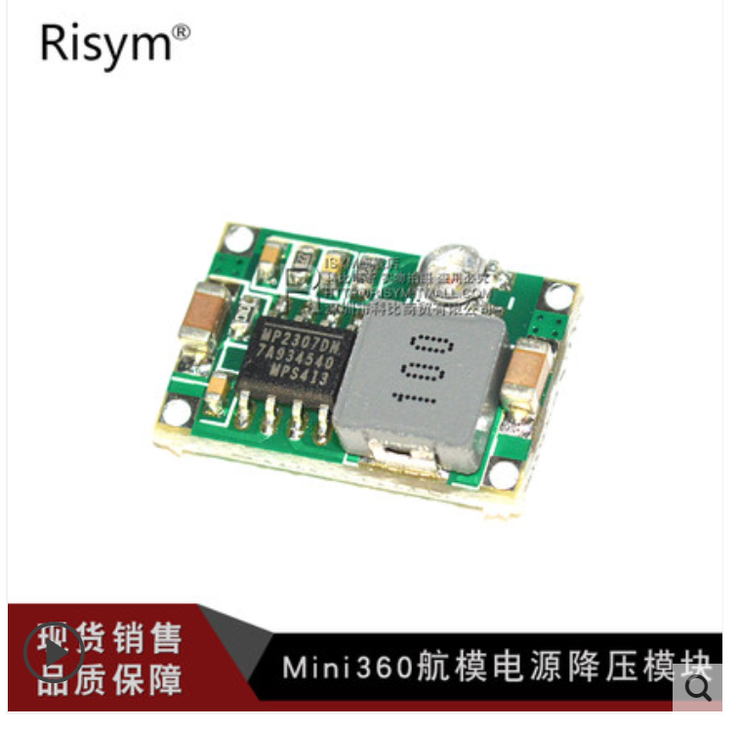
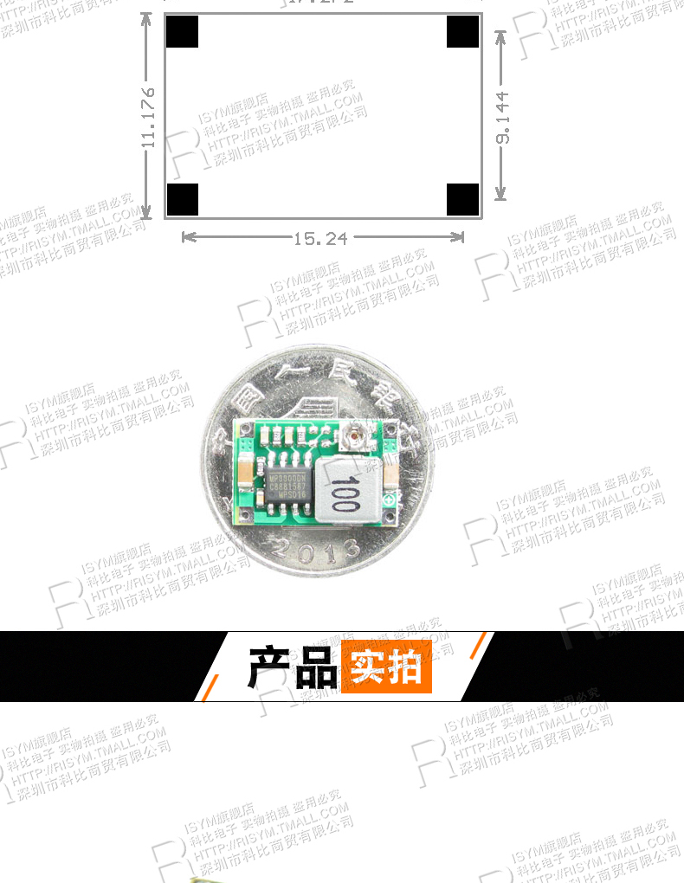
Mini 360

Slide 23
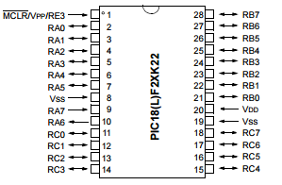
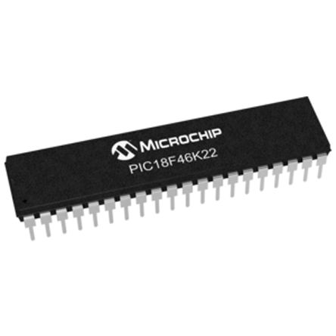
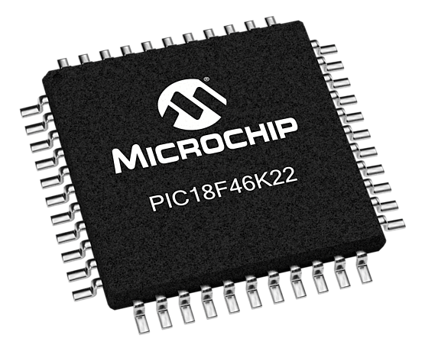
pic18f46k22

Slide 24
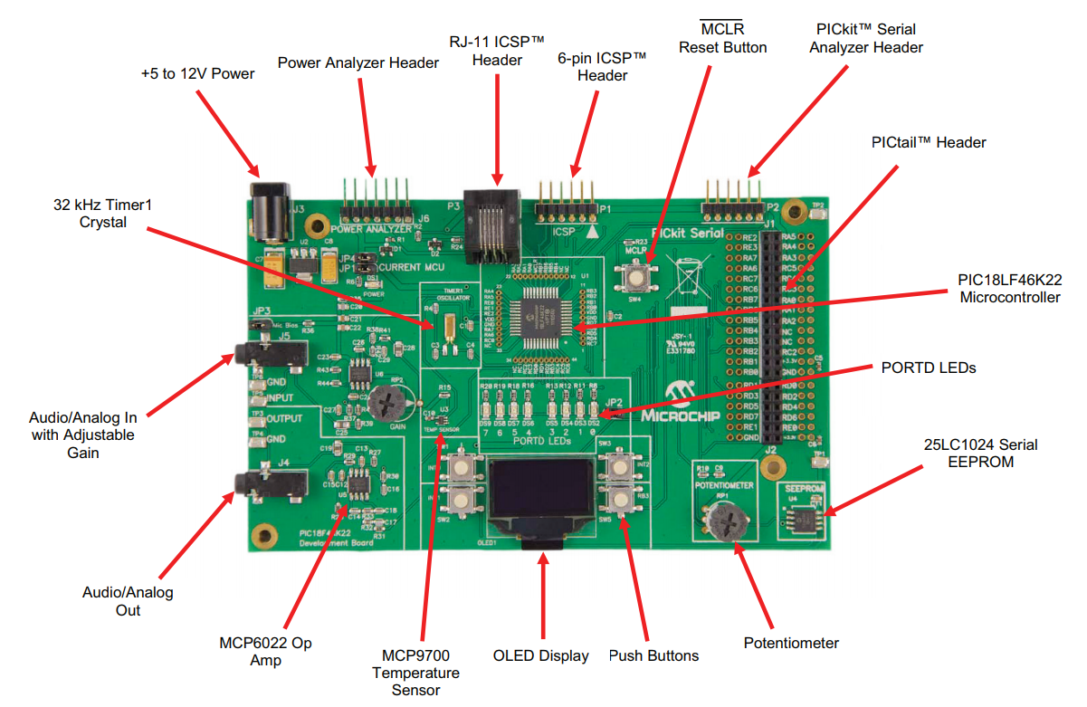
kit

Slide 25
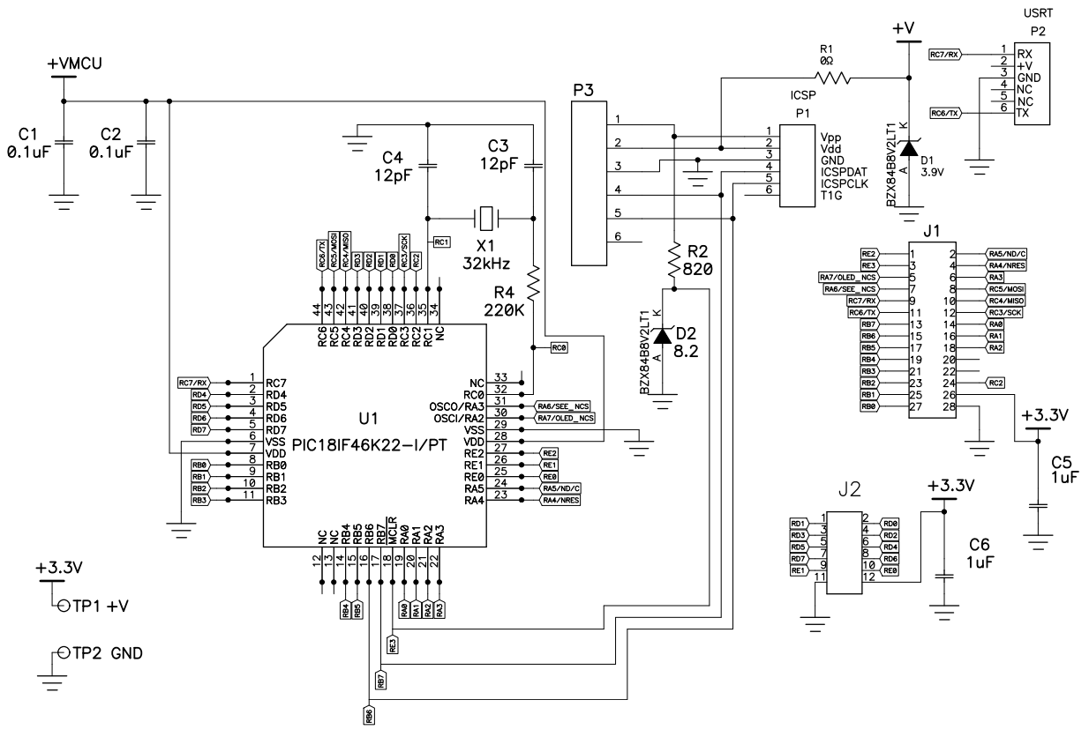
SCH

